Slide 1
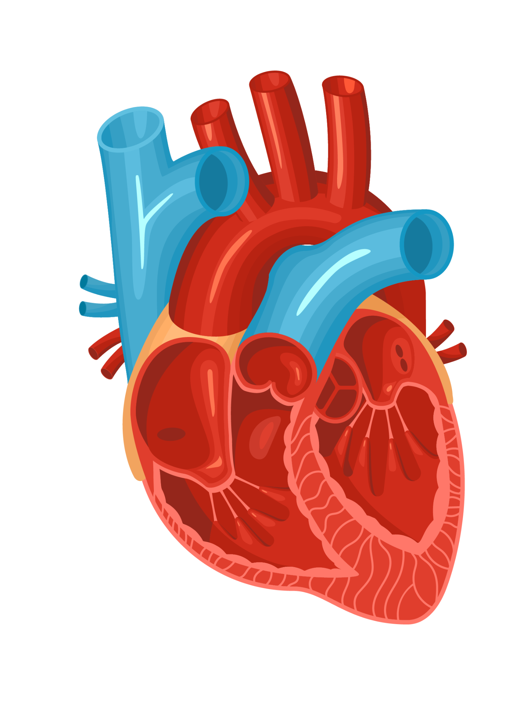
Heart Disease Machine Learning Data Analysis
Shawn Cogan
Name: Shawn Cogan
Date: 04/18/24
Assignment: ML Pres
Honor Pledge: On my honor, I pledge I have neither given nor received unauthorized aid.

Slide 2
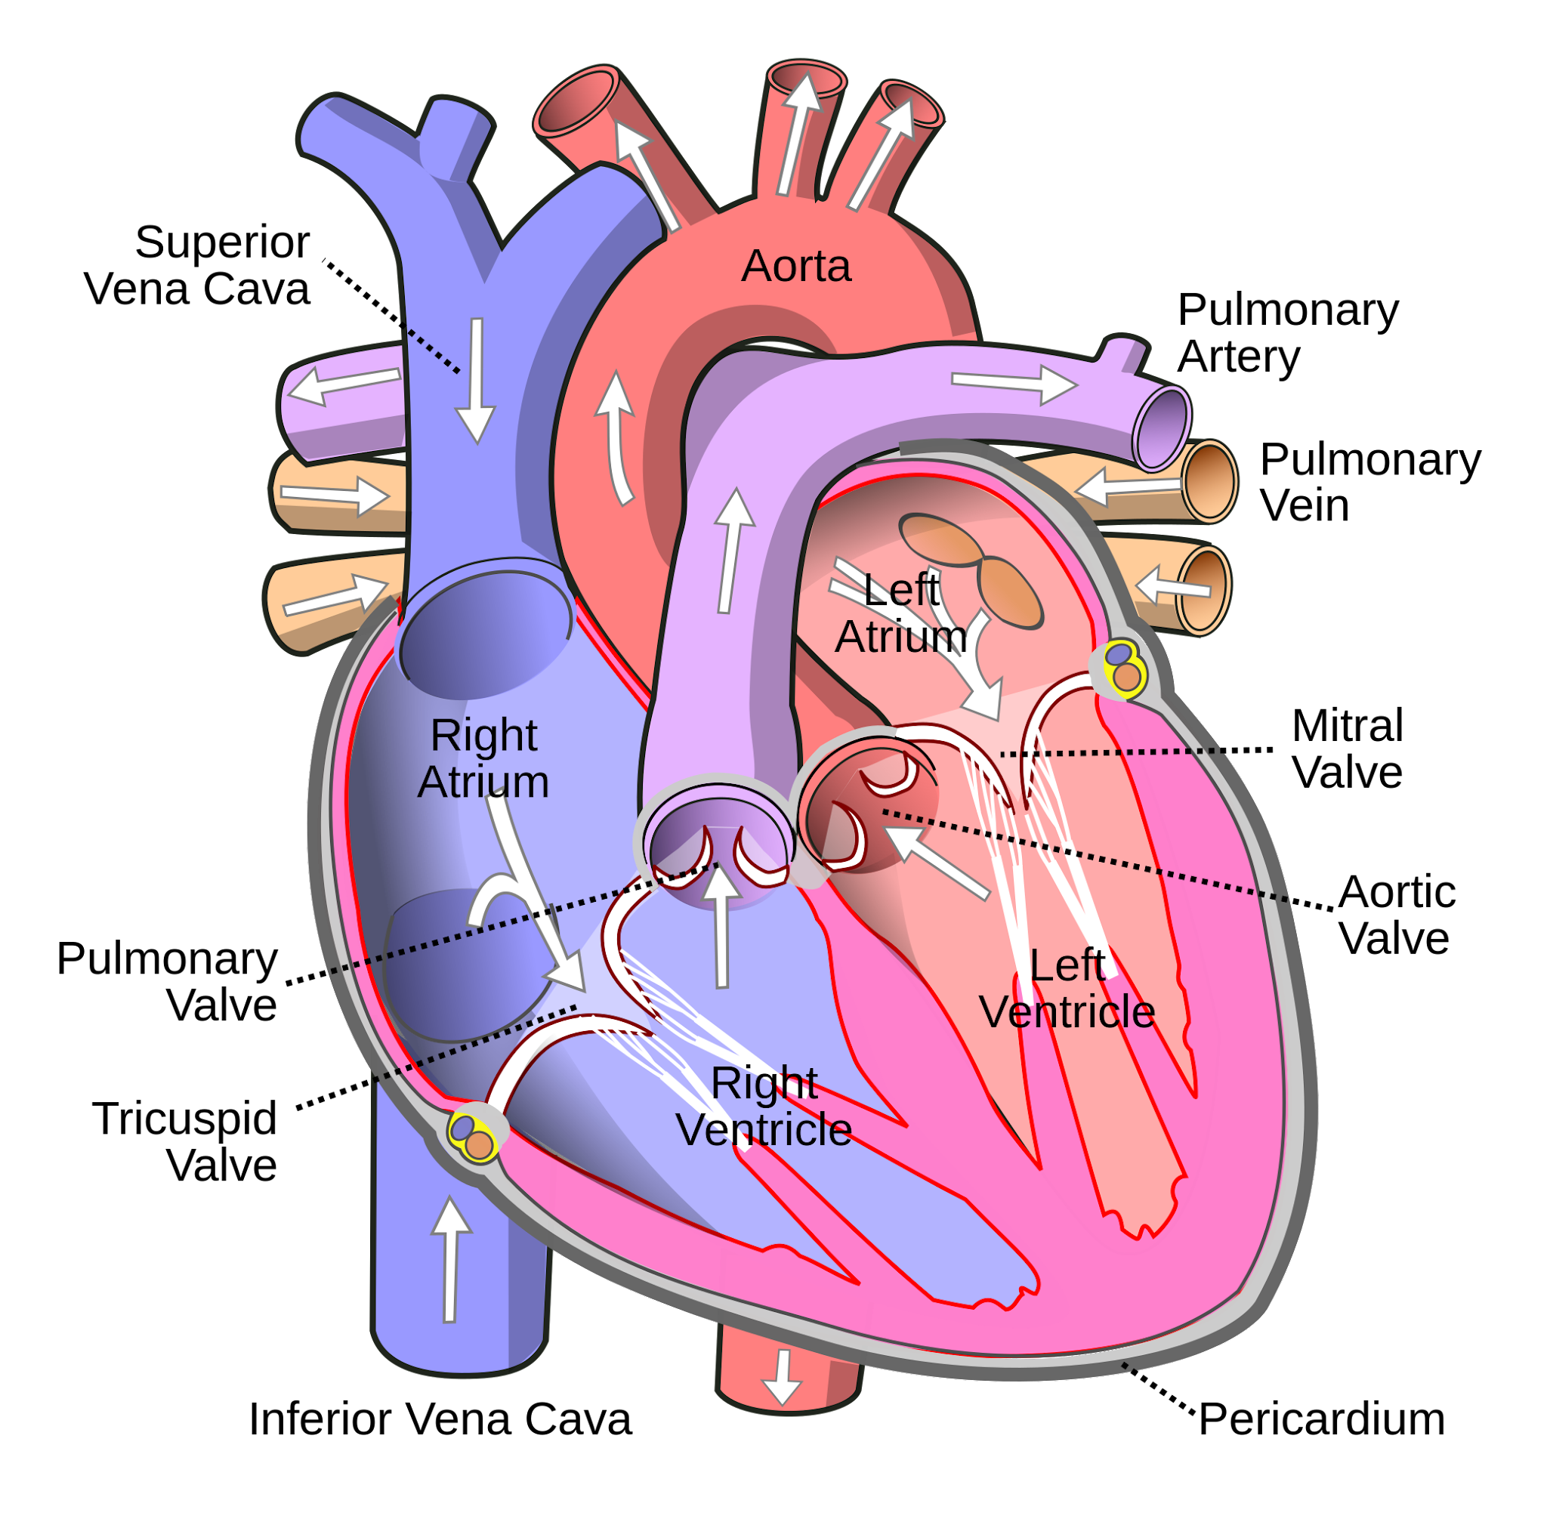
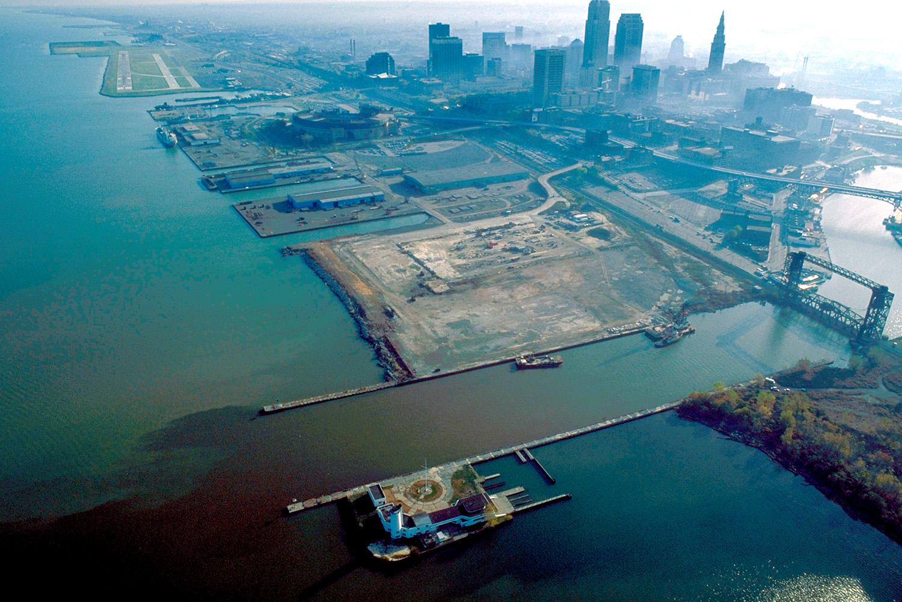
Background on Data
Used in several papers, multiple versions exist
UCI Database
Cleveland Variant
13 Attributes (75 in original set), 1 Target
303 Instances

Slide 3
13 Features
Restecg (resting elecrecardiographic results: 0 normal, 1 ST-T wave abnormality)
Thalach (max heart rate)
Exang (exercise induced angina [pain])
Oldpeak (ST depression induced by exercise)
Slope (peak exercise ST)
Ca (num major vessels from fluoroscopy [0-3])
Thal (thalassemia 3 normal, 7 fixed defects, 7 reversible defects)
Age
Sex (1 male, 0 female)
Cp (chest pain: 0 typical angina, 1 atypical angina, 2 non-anginal pain, 3 asymptomatic)
Trestbps (resting blood pressure in mmHG)
Chol (serum cholesterol in mg/dl)
Fbs (fasting blood sugar > 120 mg/dl [true/false])

Slide 4
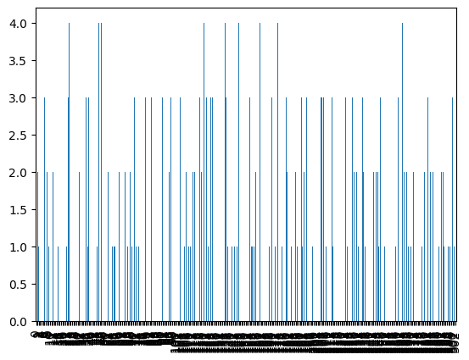
Target
“Num”
Diagnosis of heart disease ranging from 0-4
Severity
Diameter narrowing
2 is of moderate severity, 0 of little to no

Slide 5
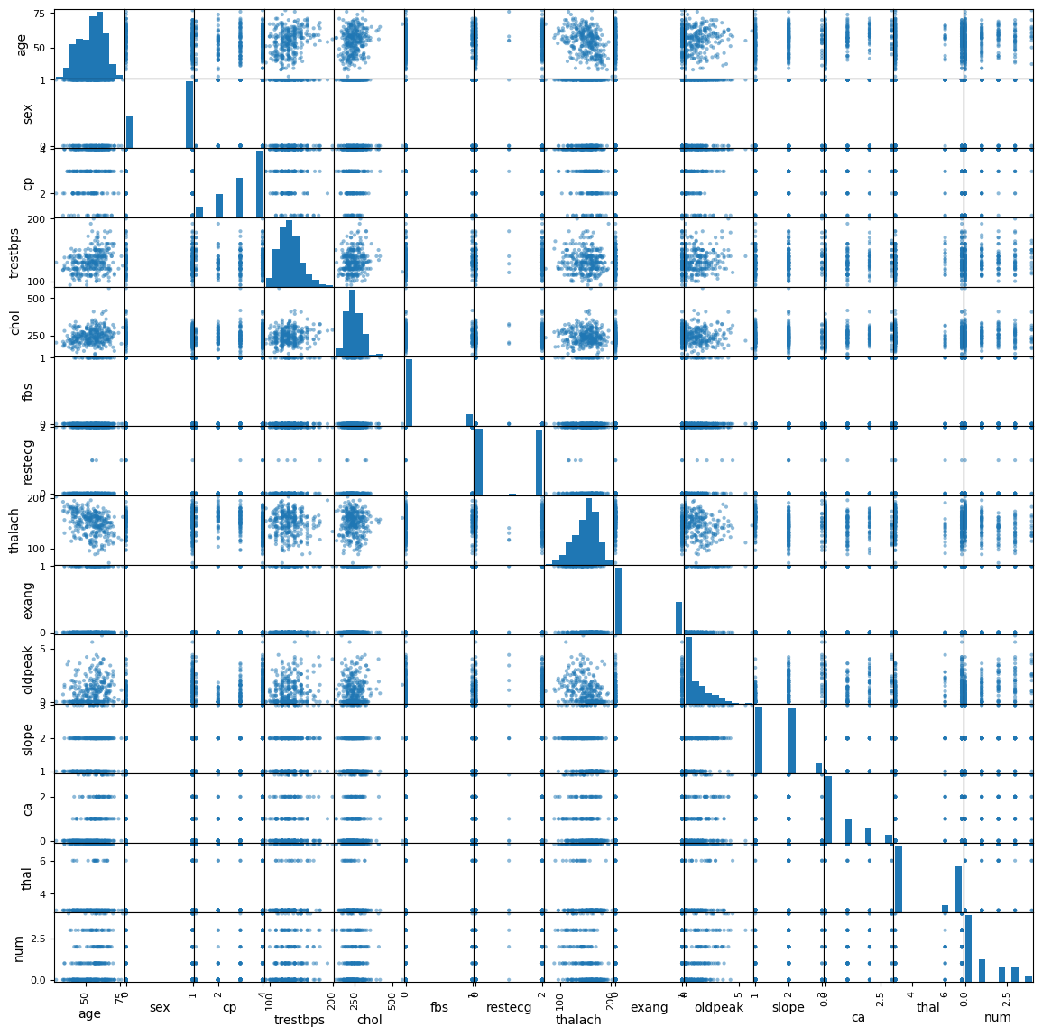
Correlations
No significant direct correlations

Slide 6
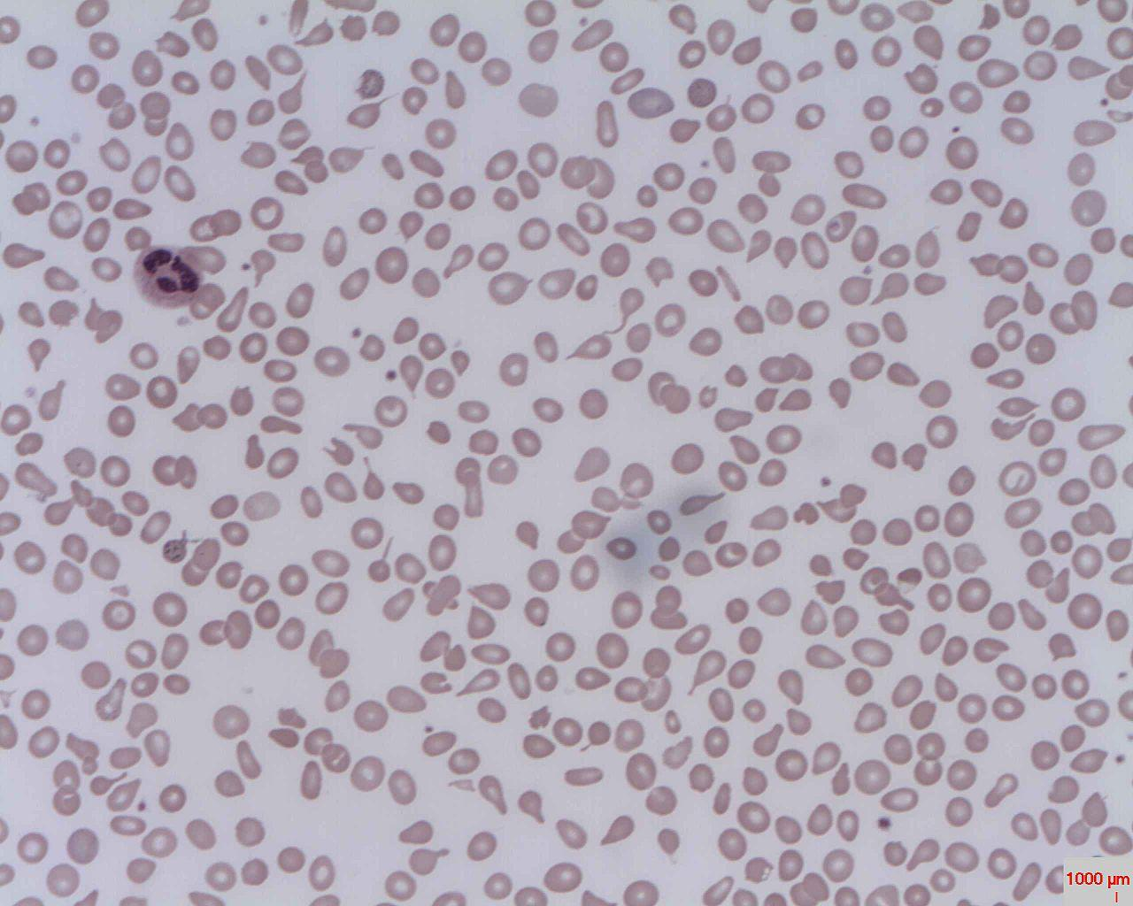
Data Processing
4 null in ca (flourscopy)
2 null in thal (thallasemia)
Likely demanding tests some people in study did not do
Replaced with most common occurring value

Slide 7
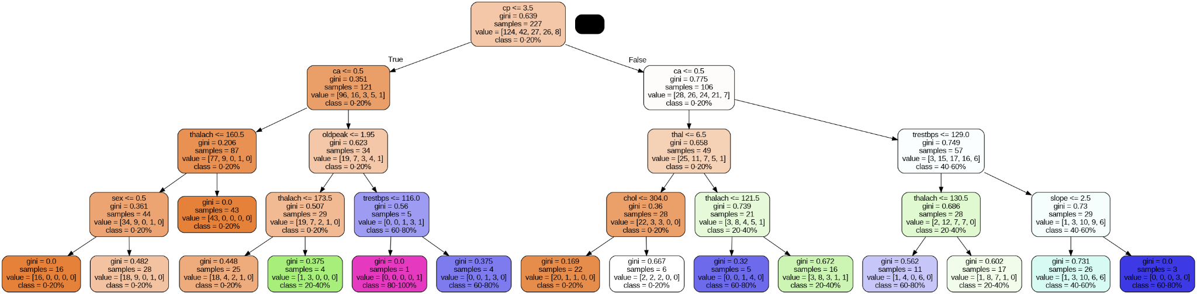
Decision Tree

Slide 8
55% Accuracy
Depth 7

Slide 9
Citation
Janosi,Andras, Steinbrunn,William, Pfisterer,Matthias, and Detrano,Robert. (1988). Heart Disease. UCI Machine Learning Repository. https://doi.org/10.24432/C52P4X.

